Slide 1



TW project: Pacman.TEAM = “Holiday Pacman”
Friday, November 16th 2022
Slide 0
Zinaida Jusufovic
Martin

Slide 2
TW project: Pacman >> print(OVERVIEW)
PACMAN Sprite
MOVEMENT
CONTROL
LIMITATIONS
NODES
NODE CLASS
CONECTIONS
GET POS. AI
SMELL TRACE AI
TABLE
VISIBLE – HTML EL
INVISIBLE – NODES
GHOSTS
CREATION
MOVEMENT
AI
Friday, November 16th 2022
Slide 1
Zinaida Jusufovic
Martin

Slide 3
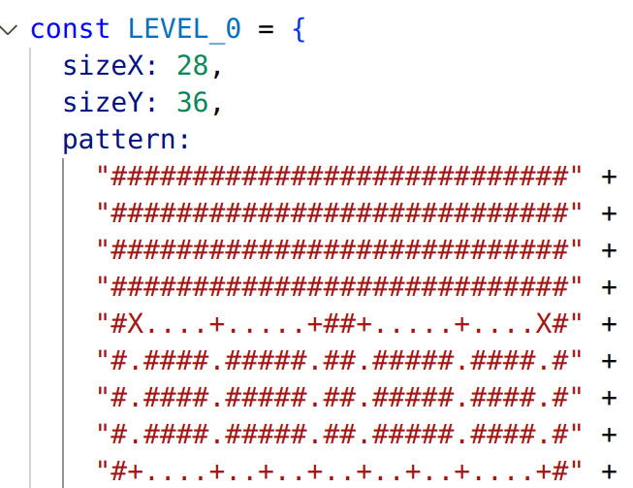
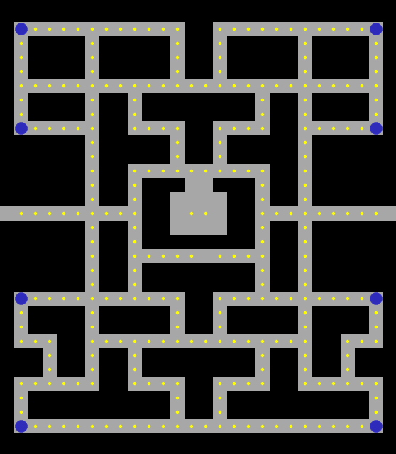
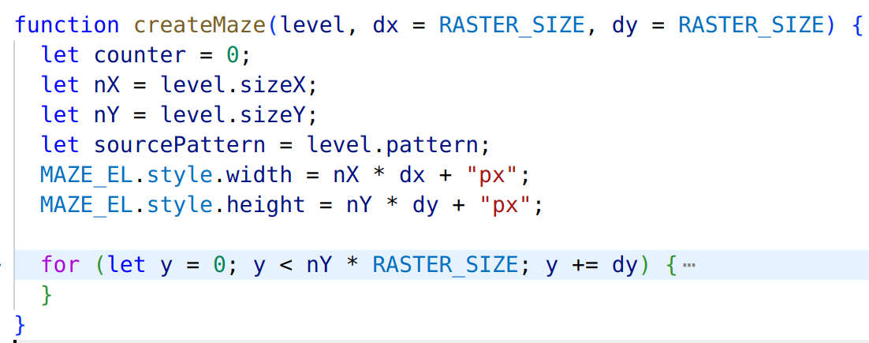
TW project: Pacman >>tableEl = getElementById(“maze”)
TABLE
VISIBLE – HTML EL
  createMaze
INVISIBLE – NODES
Friday, November 16th 2022
Slide 2
Zinaida Jusufovic
Martin

Slide 4
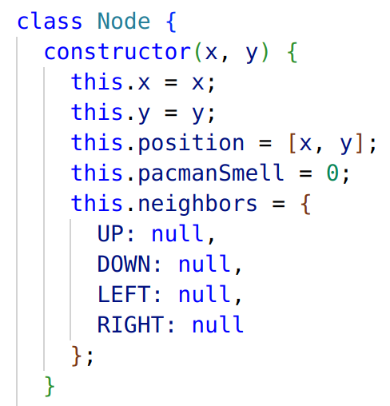
TW project: Pacman >> NODE_LIST.getNodeInfo().CODE
TABLE
VISIBLE – HTML EL
  createMaze
INVISIBLE – NODES
  NODE CLASS
Friday, November 16th 2022
Slide 3
Zinaida Jusufovic
Martin

Slide 5
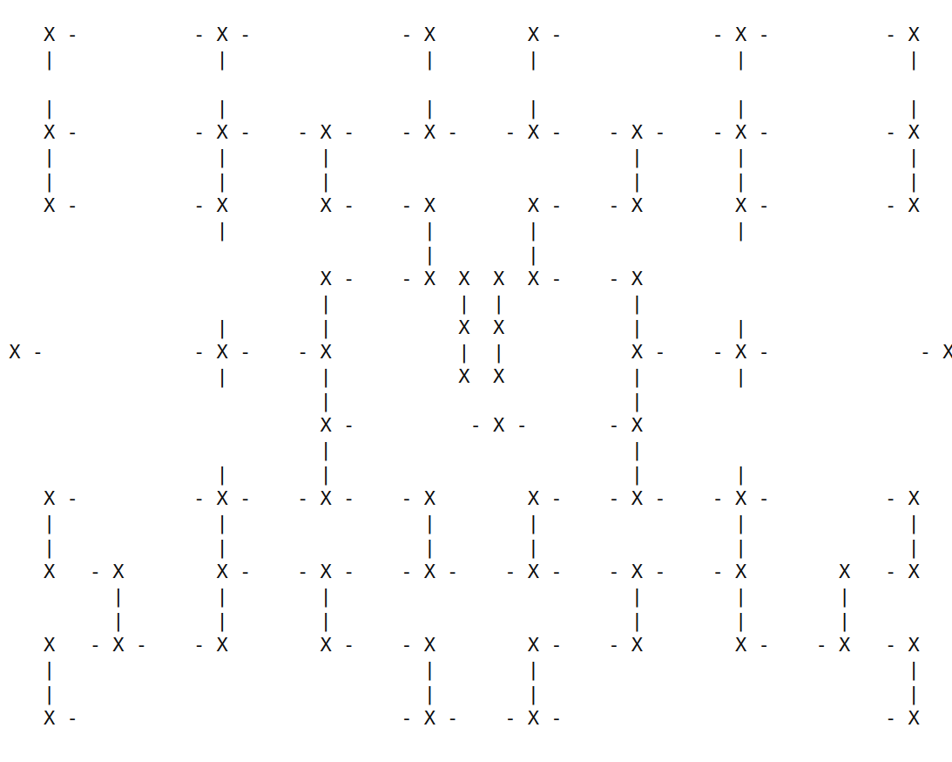
TW project: Pacman >> NODE_LIST.getNodeInfo().CONSOLE
TABLE
VISIBLE – HTML EL
  createMaze
INVISIBLE – NODES
  NODE CLASS
  NODE GRID
Friday, November 16th 2022
Slide 4
Zinaida Jusufovic
Martin

Slide 6
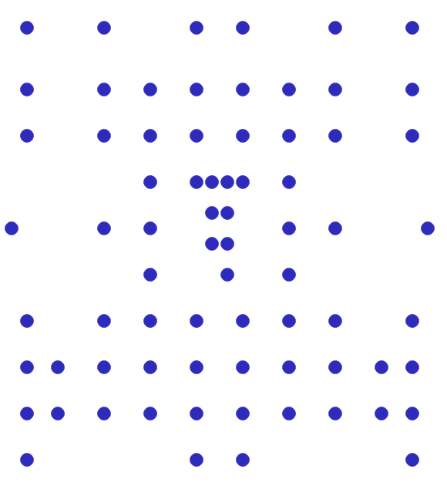
TW project: Pacman >> NODE_LIST.getNodeInfo().RENDER_NODES
TABLE
VISIBLE – HTML EL
  createMaze
INVISIBLE – NODES
  NODE CLASS
  NODE GRID
Friday, November 16th 2022
Slide 5
Zinaida Jusufovic
Martin

Slide 7
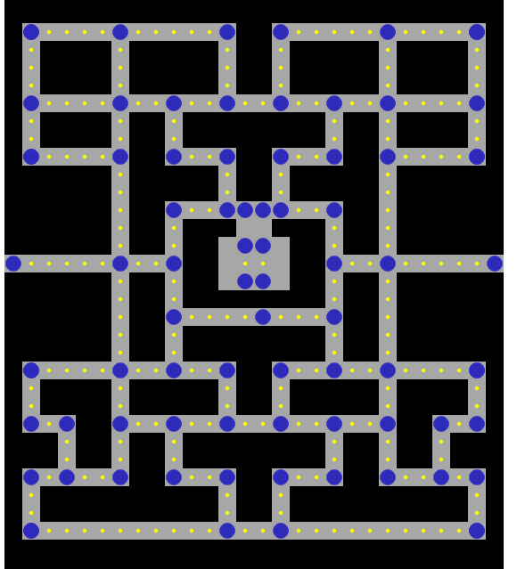
TW project: Pacman >> NODE_LIST.getNodeInfo().RENDER_ALL
TABLE
VISIBLE – HTML EL
  createMaze
INVISIBLE – NODES
  NODE CLASS
  NODE GRID
Friday, November 16th 2022
Slide 6
Zinaida Jusufovic
Martin

Slide 8
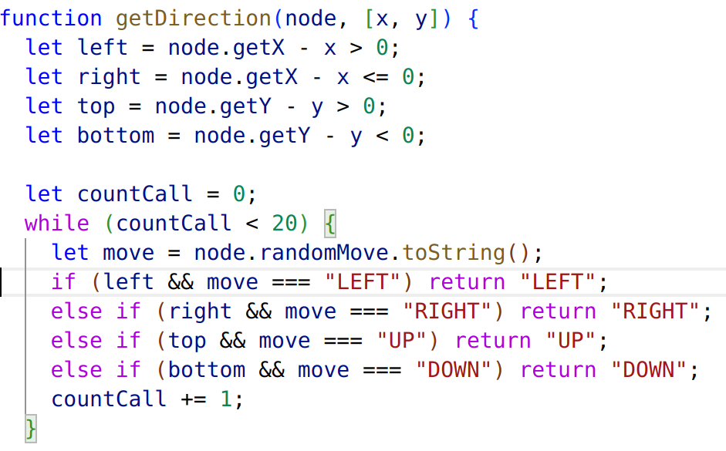
TW project: Pacman >> NODE_LIST.getDirection()
TABLE
VISIBLE – HTML EL
  createMaze
INVISIBLE – NODES
  NODE CLASS
  NODE GRID
  AI
Friday, November 16th 2022
Slide 7
Zinaida Jusufovic
Martin

Slide 9

TW project: Pacman >> NODE_LIST.setSmell(stinky)
TABLE
VISIBLE – HTML EL
  createMaze
INVISIBLE – NODES
  NODE CLASS
  NODE GRID
  AI
  TRACK SMELL
Friday, November 16th 2022
Slide 8
Zinaida Jusufovic
Martin

Slide 10
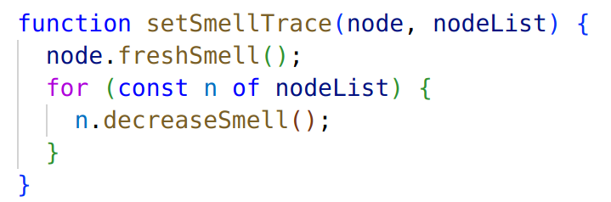
TW project: Pacman >> NODE_LIST.setSmell().TRACE
TABLE
VISIBLE – HTML EL
  createMaze
INVISIBLE – NODES
  NODE CLASS
  NODE GRID
  AI
  TRACK SMELL
Friday, November 16th 2022
Slide 9
Zinaida Jusufovic
Martin

Slide 11
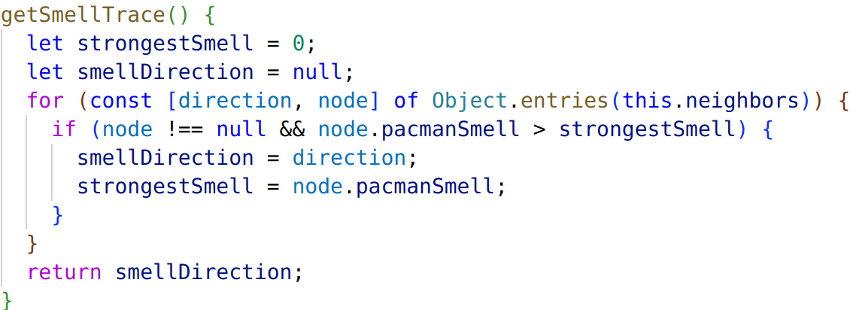
TW project: Pacman >> NODE_LIST.getSmellTrace(stinkiest)
TABLE
TRACK SMELL
Friday, November 16th 2022
Slide 10
Zinaida Jusufovic
Martin

Slide 12

TW project: CTRL + C
Friday, November 16th 2022
Slide 11
Zinaida Jusufovic
Martin

